Slide 1
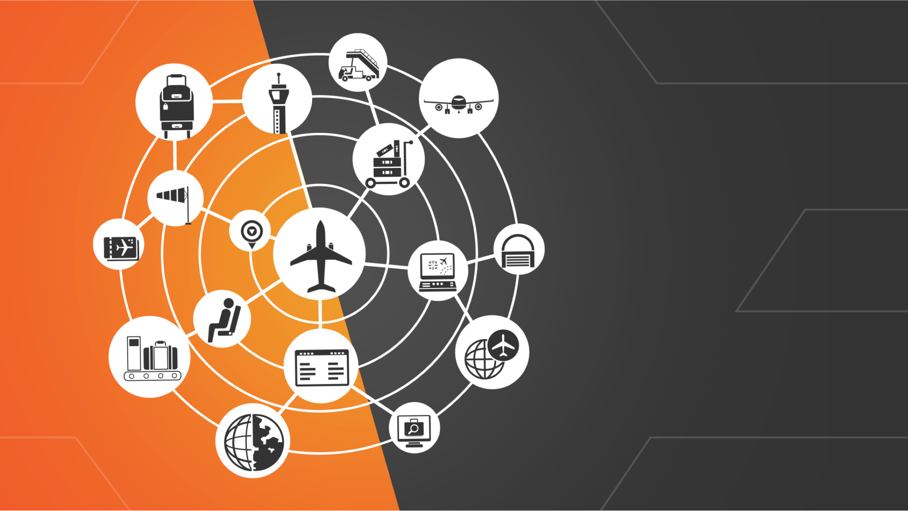
FL3XX Pricing Engine
Unlock Your Pricing Potential

Slide 2
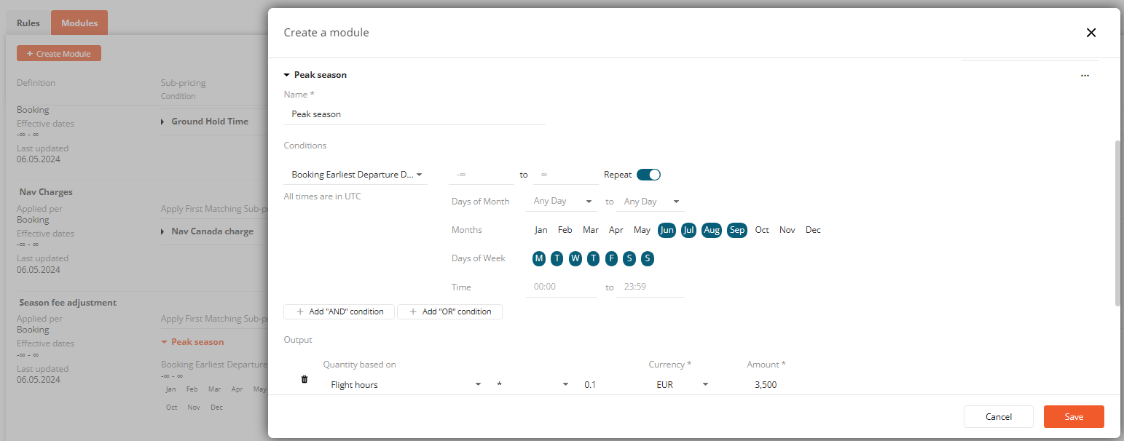
Modules: The Building Blocks of Your Pricing
Define Modules
Customize Pricing Items
Modules are the fundamental building blocks of the Pricing Engine. They allow you to group and define specific pricing line items based on your unique requirements. Each module can have its own set of conditions and pricing calculations method, giving you the flexibility to tailor your pricing to different scenarios.
Once you've set the conditions, you can specify the price, currency, and calculation method, such as using flight hours, distance, or a fixed amount. You can also apply multipliers or set minimum and maximum values to further refine your pricing calculations.
1
2
3
Set Conditions
Within each module, you can define conditions pthat determine when a specific pricing item should be applied. These conditions can be based on a wide range of factors, such as aircraft type, customer type, flight dates, and more. By setting the right conditions, you can ensure your pricing is tailored to your specific business needs.

Slide 3
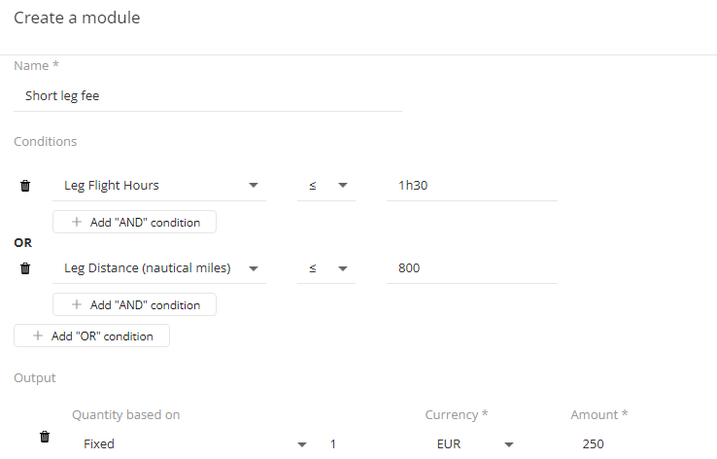
Conditions: The Backbone of Your Pricing
1
Comprehensive Conditions
2
Advanced Configuration
3
Flexibility and Granularity
The Pricing Engine offers a wide range of conditions that you can use to tailor your pricing. These conditions cover various aspects of your business, such as account, aircraft, customer, flight details, and workflow. By carefully selecting and combining these conditions, you can create highly specific and tailored pricing rules.
The conditions in the Pricing Engine go beyond simple checks. They allow you to define complex logic using AND-OR operators, enabling you to create intricate pricing rules that cater to your unique business requirements. This level of customization ensures your pricing is optimized for maximum efficiency and competitiveness.
The Pricing Engine's conditions can be applied at both the booking and leg level, providing you with the flexibility to adjust your pricing based on specific details of the trip. This granular level of control allows you to fine-tune your pricing to meet the needs of your customers and stay ahead of the competition.

Slide 4
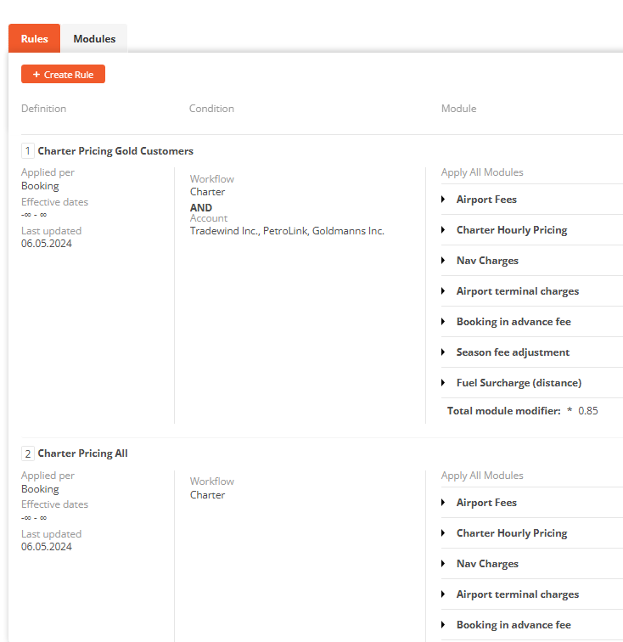
Rules: Bridging Modules and Quotes
Understand Rules
Rules are the crucial link between your modules and the quotes you generate. They determine which module should be applied based on specific conditions. When creating a quote, the system checks the applicable rule and applies linked modules with the corresponding pricing items.
Creating a rule involves defining the conditions that must be met for the rule to be applicable to the quote. These conditions can be based on a wide range of factors, such as account, aircraft, customer, workflow, and more. By setting the right rule conditions, you can ensure your pricing is applied accurately and consistently across your quotes.
Define Rule Conditions
Manage Modules and Rules
The Pricing Engine provides you with the flexibility to review, edit, delete, duplicate, and deactivate your modules and rules as needed. This allows you to continuously refine and optimize your pricing strategy to adapt to changing market conditions and customer needs.

Slide 5
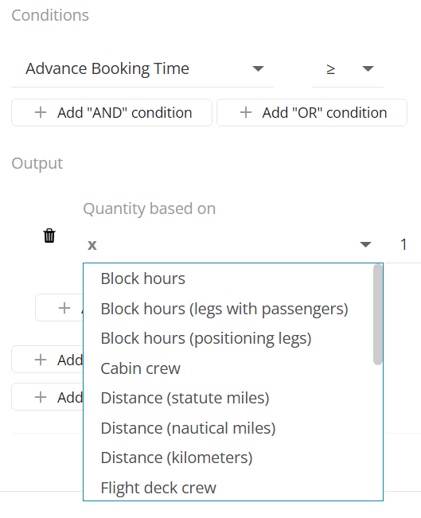
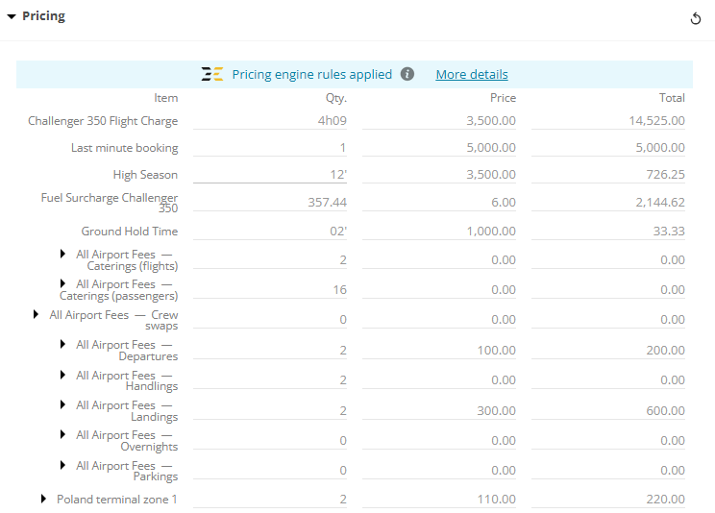
Outputs: Calculate Pricing with Precision
Diverse Calculation Methods
Streamlined Workflow
The integration of the Pricing Engine with the broader FL3XX platform ensures a seamless workflow for your pricing and quoting processes. By leveraging data and calculations from other modules, such as aircraft information and airport fees, the Pricing Engine streamlines your operations and reduces the risk of manual errors, saving you time and improving efficiency.
The Pricing Engine offers a wide range of calculation methods for your pricing outputs, including block hours, flight hours, distance, and more. This allows you to choose the most appropriate method based on your business model and the specific needs of your customers, ensuring accurate and competitive pricing.
Customizable Outputs
Beyond the standard calculation methods, the Pricing Engine also provides the ability to customize your pricing outputs. You can apply multipliers, set minimum and maximum values, and even incorporate specific fees, such as airport fees, into your pricing calculations. This level of customization enables you to fine-tune your pricing to maximize profitability and meet your clients' expectations.

Slide 6
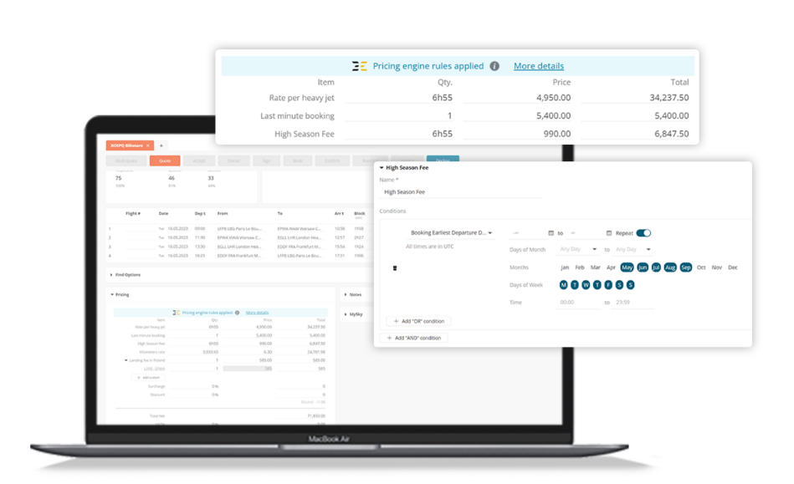
Pricing in Action : Real-World Examples
Aircraft-Based Pricing
Customer-Specific Pricing
Seasonal Pricing
Workflow-Based Pricing
Adjust your pricing based on the specific aircraft being used for a flight, taking into account factors like aircraft type, category, OpsTeam filter and more.
Implement customized pricing for different customer segments, such as VIPs, corporate clients, or specific account holders, to cater to their unique needs and preferences.
Implement dynamic pricing strategies that adjust based on factors like peak travel seasons, holidays, or specific date ranges to maximize revenue and meet market demands.
Tailor your pricing based on the specific workflow associated with a booking, such as charter, scheduled, or ad-hoc flights, to ensure accurate and appropriate pricing for each scenario.

